Slide 1

An intuitive explanation of how neural networks work
Akshaya Kadidal(AK)
06 Aug 2024
Notes:
Hi Everyone. My name is Akshay Kadidal. For those of you who may struggle with my name I go by AK as well.

Slide 2


Motivation
Neural Network is a back box algorithm. Nobody knows What it is doing
Somebody!
Black Box Algorithm
Neuron
Parameters
Hidden layers
Cost function
Forward Propagation
Back Propagation
Content Generation Supported by

Slide 3





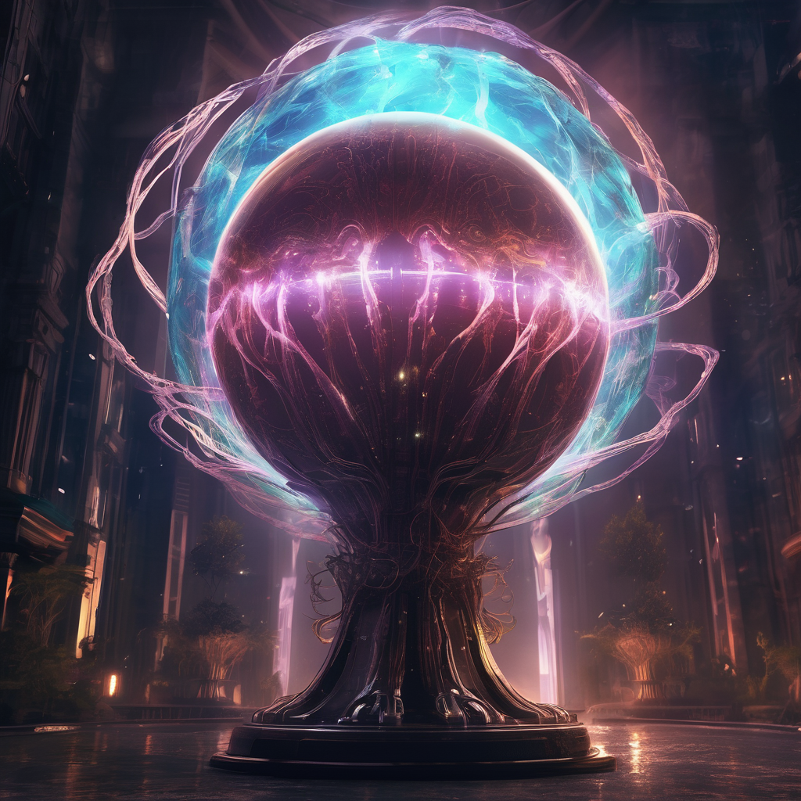


Saving Zorphlings!
Kevin the Kinetic Artisan
Andrew the Alien Biologist
Zorphlings
The Orb of Oron
Maya the Mathematician
Caroline the Chemist
Content Generation Supported by

Slide 4



The Problem
Mechanical Input
13.7454
19.50714
17.31994
15.98658
Output
23.79544
33.61789
36.27205
14.77335
Chemical Input
11.22038
14.95177
10.34389
19.0932
ERROR
ERROR
ERROR
The Orb of Oron
Content Generation Supported by

Slide 5





The Game
Mechanical Input
Output
Chemical Input
Content Generation Supported by

Slide 6
Forward Propagation
W1
W5
W9
b1
b3
Mechanical Input
Output
W2
W3
W6
W7
b5
W10
W4
W8
Chemical Input
b2
b4
Content Generation Supported by

Slide 7
Forward Propagation
2*2 +3*4 +1=15
15*5+10*3+3=108
1
5
1
1
3
2
102
Output
4
1
3
2
2*1+ 3*3 -1 =10
7
-27
3
3
-2
3
-1
-3
Content Generation Supported by

Slide 8
The Cost Function
Average(
)
Output
-
Know Historical Output
102
5
97
.
.
This cost function is called MAE (Mean Absolute Error)
.
Content Generation Supported by

Slide 9
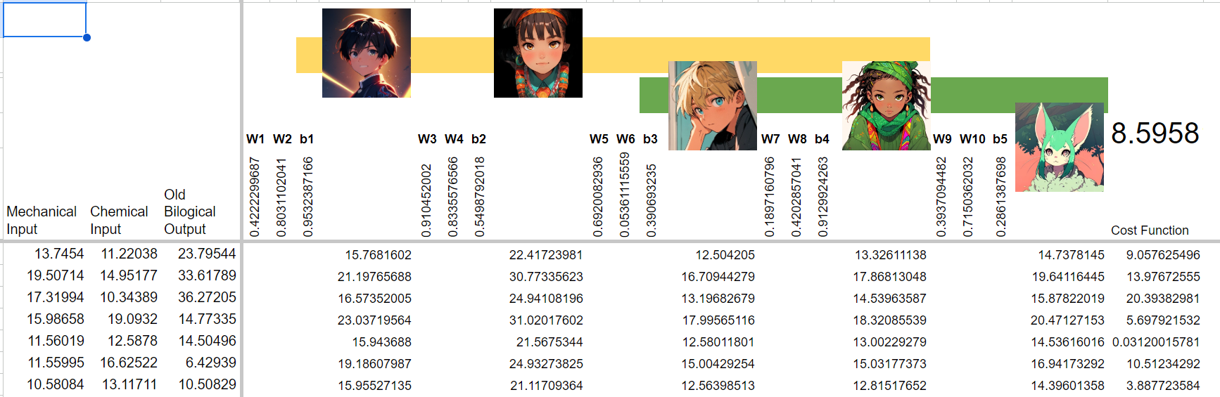
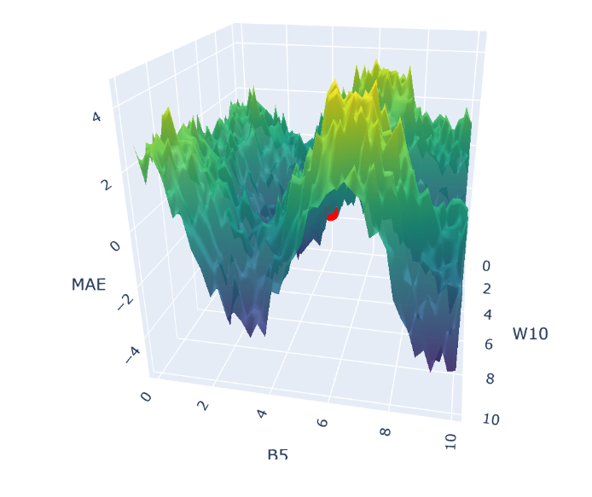

Let's Do the Math
Spreadsheet
Visualization
Git Repository with files
Content Generation Supported by

Slide 10
Back Propagation
W1
W5
W10
Is The COST
Decreasing?
Or
Increasing?
b1
b3
W2
W3
W6
W7
b5
W9
W4
W8
b2
b4
Content Generation Supported by

Slide 11




Terminologies - Neurons
W1
W5
W10
Mechanical Input
b1
b3
Output
W2
W3
W6
W7
b5
Chemical Input
W9
W4
W8
b2
b4
Content Generation Supported by

Slide 12

Terminologies - Parameters
W1
W5
W10
Mechanical Input
b1
b3
Output
W2
W3
W6
W7
Chemical Input
b5
W9
W4
W8
b2
b4
Content Generation Supported by

Slide 13
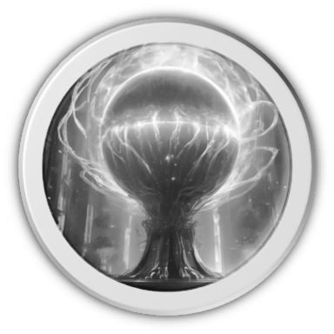
Terminologies - Layers
Mechanical Input
Chemical Input
Input Layer
Hidden Layers
Output Layer
Content Generation Supported by

Slide 14
Thank you

Slide 15
Useful / Fun links
https://playground.tensorflow.org/#activation=tanh&batchSize=10&dataset=circle&regDataset=reg-plane&learningRate=0.03&regularizationRate=0&noise=0&networkShape=4,2&seed=0.59593&showTestData=false&discretize=false&percTrainData=50&x=true&y=true&xTimesY=false&xSquared=false&ySquared=false&cosX=false&sinX=false&cosY=false&sinY=false&collectStats=false&problem=classification&initZero=false&hideText=false

